Slide 1
Generative Adversarial Networks
Group 2
Notes:
Hello guys, today we will talk about Generative adversarial networks or gans for short.(Javin)

Slide 2
Contents
Gans and Structure
Gan usage and dataset
CGans
DCGans
Performances
Notes:
We will talk about the Gans and structure, gan usage and dataset, cGans, DCGans and their performances(Javin)

Slide 3
1.
GANS AND STRUCTURE
Let’s start by discussing the Structure of the Gan
Notes:
Let’s start by discussing the structure of the Gan.(javin)

Slide 4
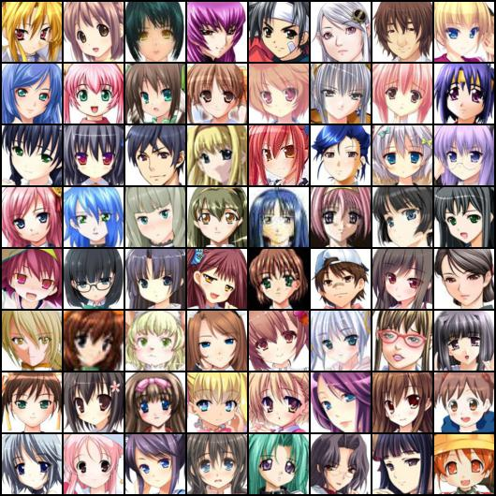
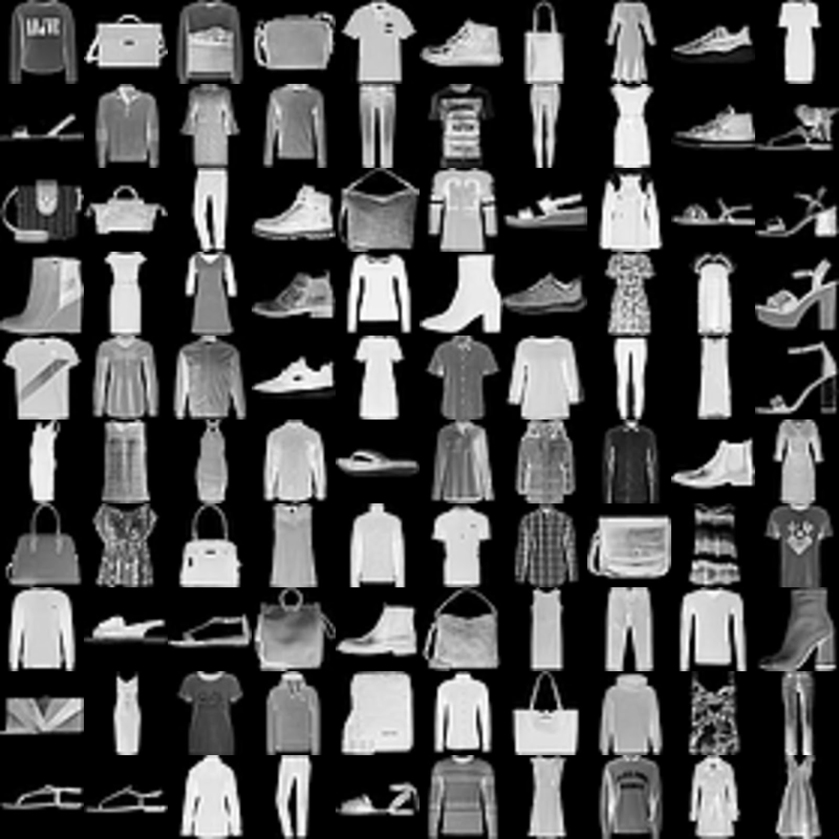
GANS USAGES AND DATASETS
Anime is a very popular form of entertainment today. In January 2018 it is estimated that that the anime website Crunchyroll got 71 million visitors in a month. This was more than the monthly average netflix users as of september 2019 of 46.55 million which is a crazy difference. The number one rated anime in germany is Code Geass: Lelouch of the Rebellion. We thought it was fitting to try to work with a anime database which contains 63536 images of anime faces. We also trained our models on the fashion-mnist.
Notes:
For our project we chose the dataset of picture of anime faces and the fashion mnist dataset. Anime is a very popular form of entertainment today. In fact the anime hosting website Crunchyroll got 71 million visitors in January 2018 which beat netflix’s average of 46.55 million users. Because of this we wanted to experiment with gans on the anime face dataset which consists of 65,536 images of anime faces. (Javin)

Slide 5
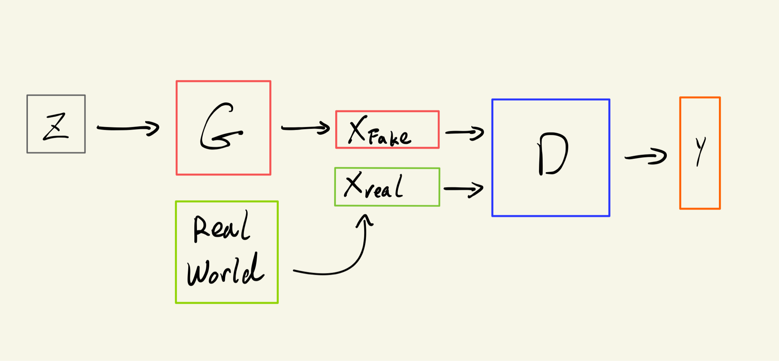
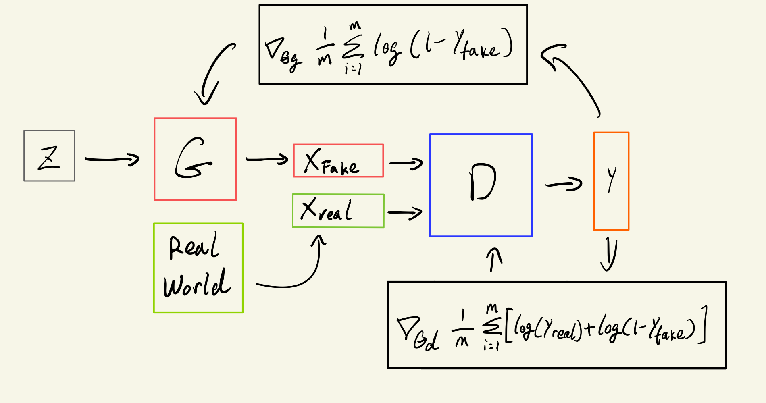
Gan Structure
GAN is an Algorithm that applies two competing neural networks (the generator and the Discriminator). The generator generate fake data (xfake) which we pass to the discriminator which tries to discriminate the false data.
Notes:
We’ll now talk about our Gan structure. A gan is a an algorithm that applies two competing neural networks(the generator and the discriminator) against each other. The generator’s job is to generate fake data(xfake) which we then pass to the discriminator that tries to discriminate the false data. the generator wants its fake images to trick the discriminator, and the discriminator wants to identify the fake images from the real ones as accurate as possible.
(Javin)

Slide 6
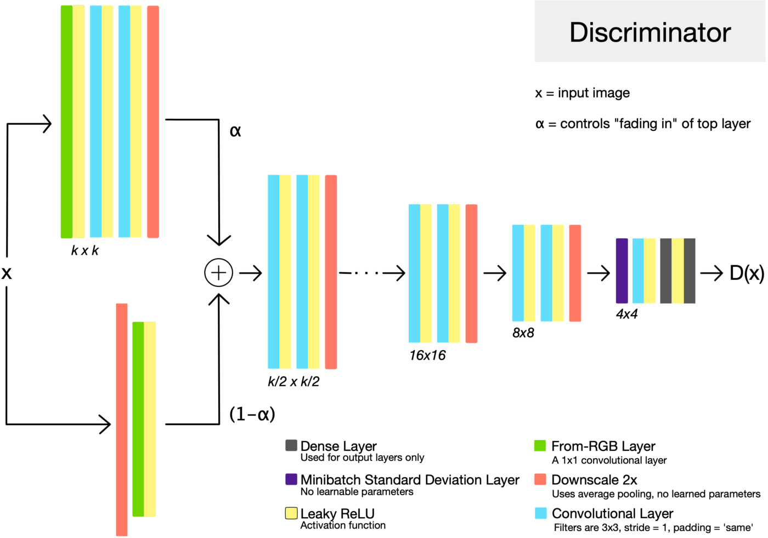
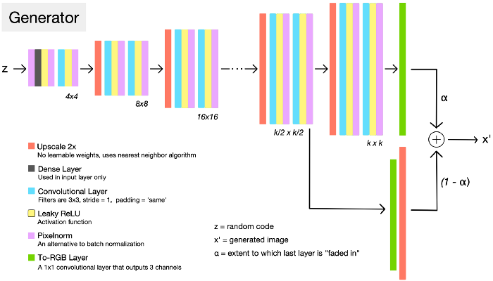
GANS MODEL IMPLEMENTATION USING TENSORFLOW
The Discriminator is made with layers of dense layers followed by an leaky relu and then a drop out layer to help with overfitting. We also have a batch normalization layer at the end. These layers are stacked to make the discriminator. The final two layers is the flatten layer followed by a final dense layer for the final prediction. The generator is made with a dense layer followed by batch normalization and ReLu and then a convolutional network. The layers are stacked on top of each other.
Notes:
The discriminator is made with layers of dense layers followed by an leaky relu and then a drop out layer to help with overfitting. We also have a batch normalization layer at the end. These layers are stacked to make the discriminator. The final two layers is the flatten layer followed by a final dense layer for the final prediction. The generator is made with a dense layer followed by a batch normalization and RElu and then a convolutional network. The layers are stacked on top of each other. (Javin)

Slide 7
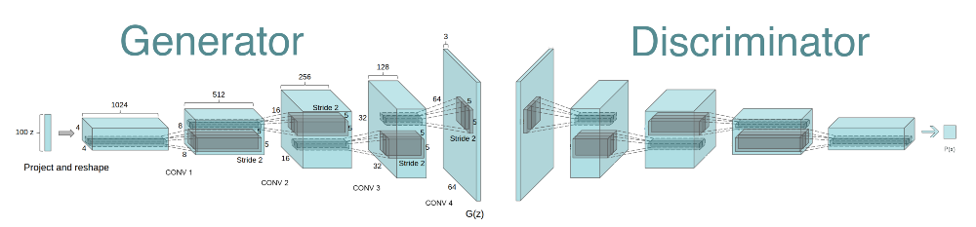
DCGAN Structure
Upsample with stride 2 transposed convolution
Generator uses ReLU activation
Discriminator uses Leaky ReLU activation
No pooling layer
Notes:
A DCGAN structure is very similar to that of the GAN structure, except that we replace the fully connected layers with convolutional layers to better capture the spatial information. There are a few special designs in the DCGAN structure. First, all the pooling layers are replaced by convolutional layers with stride 2, besides, we apply batch normalization in both the generator and discriminator to accelerate the training process. (Ethan)

Slide 8
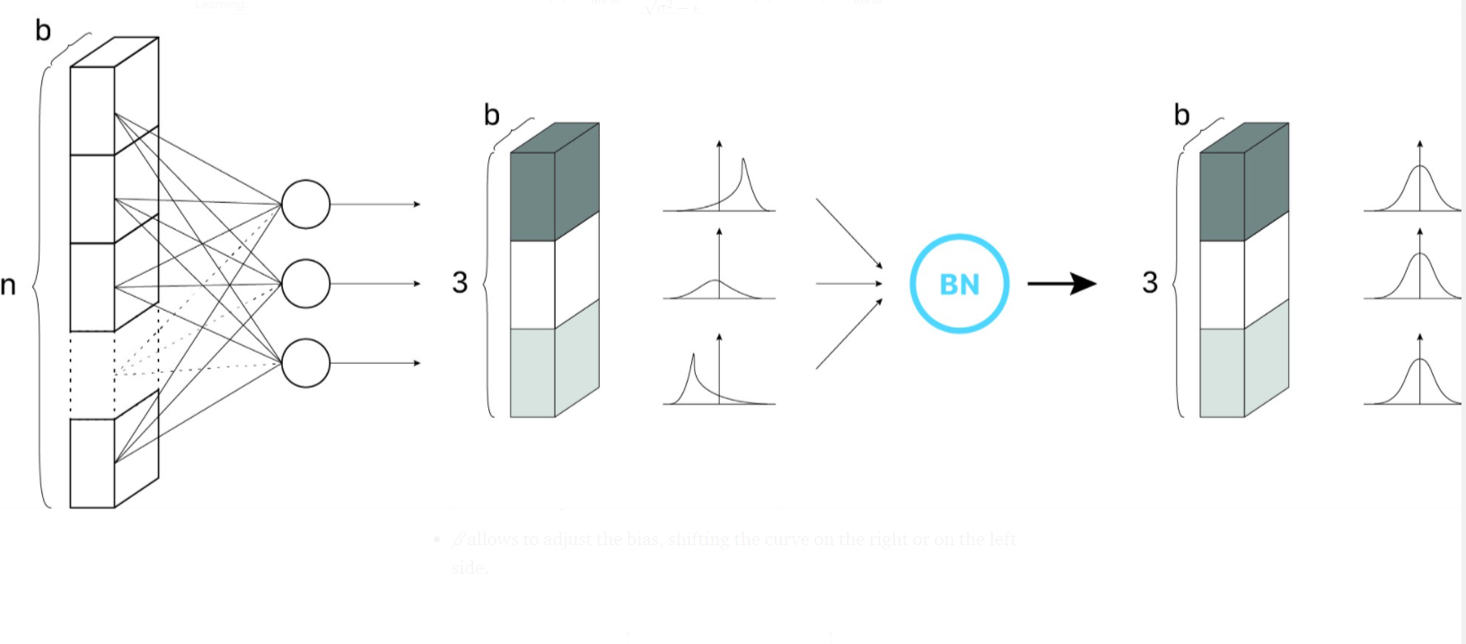
Batch normalization
Notes:
Just a side note about batch normalization, during the process of back propagation, the weights of a certain layer gets updated with an assumption that the weights from the previous layer do not change. But in reality, all weights get updated. And the distribution of the weights from previous layer is also likely to change. Batch normalization helps standardize the weights computed in each layer to follow a standard normal distribution, allowing the model to generalize better and reduce the number of steps needed to train a model.(Ethan)

Slide 9
Generator
Input
(128, 128)
Dense
(128, 4096)
Conv2DTrans
(128, 4, 4, 256)
Conv2DTrans
(128, 32, 32, 32)
Conv2DTrans
(128, 16, 16, 64)
Conv2DTrans
(128, 8, 8, 128)
Conv2DTrans
(128, 64, 64, 3)
Notes:
The dimension of each layer in the generator is shown above. To begin with, we randomly pick points from a 128 dimensional latent space, and upsampled them with transposed convolutional layers until it’s size matches with the input of the discriminator. Batch normalization and ReLU activation is applied to every layer except the first and last one, but for simplicity, we did not plot them out. (Ethan)

Slide 10
Discriminator
Input
(128, 64, 64, 3)
Conv2D
(128, 32, 32, 32)
Conv2D
(128, 16, 16, 64)
Dense
(128, 1)
Conv2D
(128, 4, 4, 256)
Conv2D
(128, 8, 8, 128)
Notes:
In the discriminator, we downsample the output of the generator using convolutional layers with stride 2, then a binary prediction is made with a dense layer in the end. (Ethan)

Slide 11
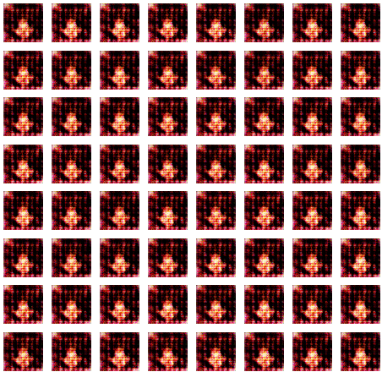
Failed Example
Notes:
GAN is based on a zero-sum game, this is an example of the discriminator being much stronger than the generator, where the distribution of generated images does not converge to that of the real distribution. To prevent that, we can weaken the discriminator by reducing the number of layers, or train multiple iterations on the generator to one iteration on the discriminator.(Ethan)

Slide 12
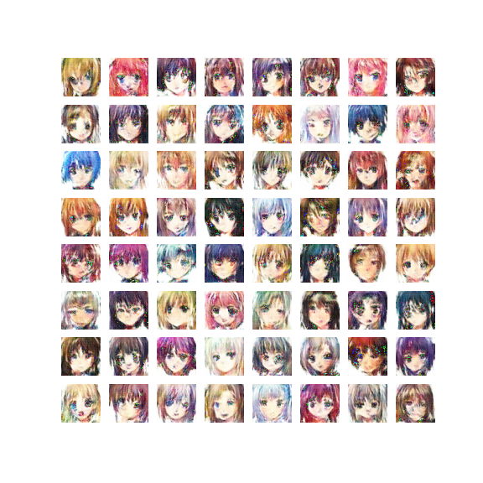
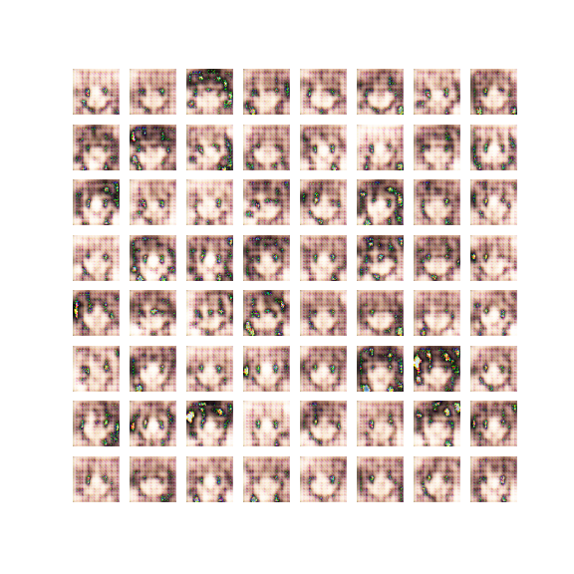
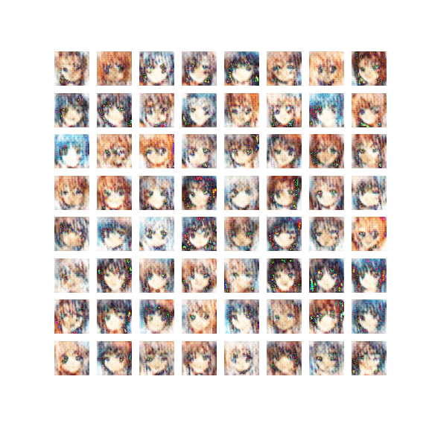
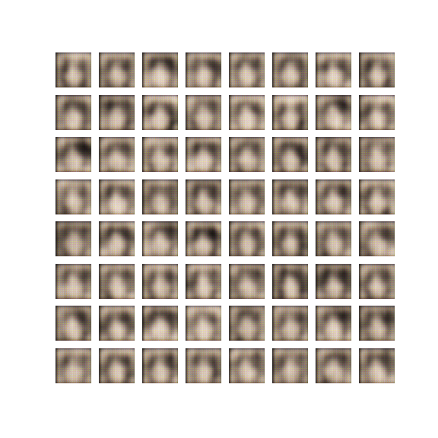
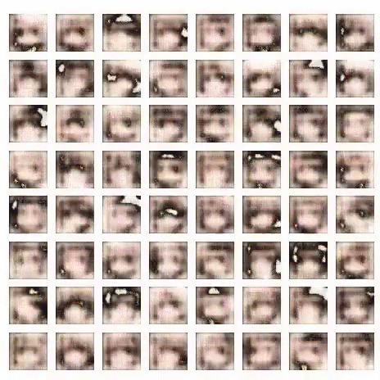
DCGAN Result
Notes:
This is the output of our generator over 300 epochs. We can see the contour of the characters’ face right after the first epoch of training. And In epoch 7, we can see the character’s face and mouth, but the first few epochs doesn’t have the color identity. Until epoch 35, we can finally see some colorized outputs. And the model basically stopped improving around epoch 150. (Andy)

Slide 13
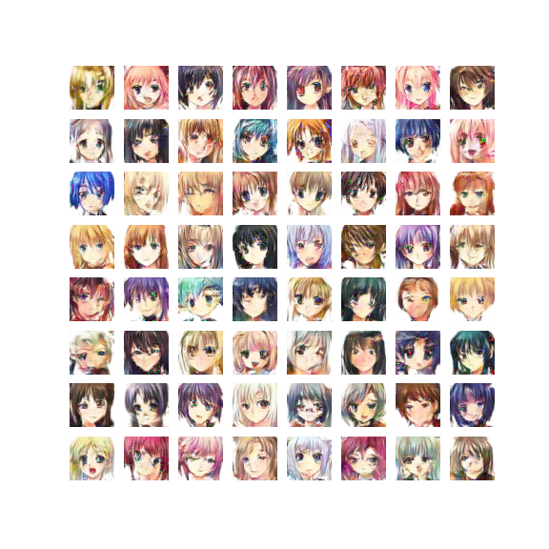
DCGAN Result
Notes:
This is the final result of DCGAN over 300 epochs. As you can see, the model can mimic the hair texture pretty well but having some troubles generating the eyes. This is probably due to that the anime characters in the dataset have different shapes and sizes of eyes. (Andy)

Slide 14
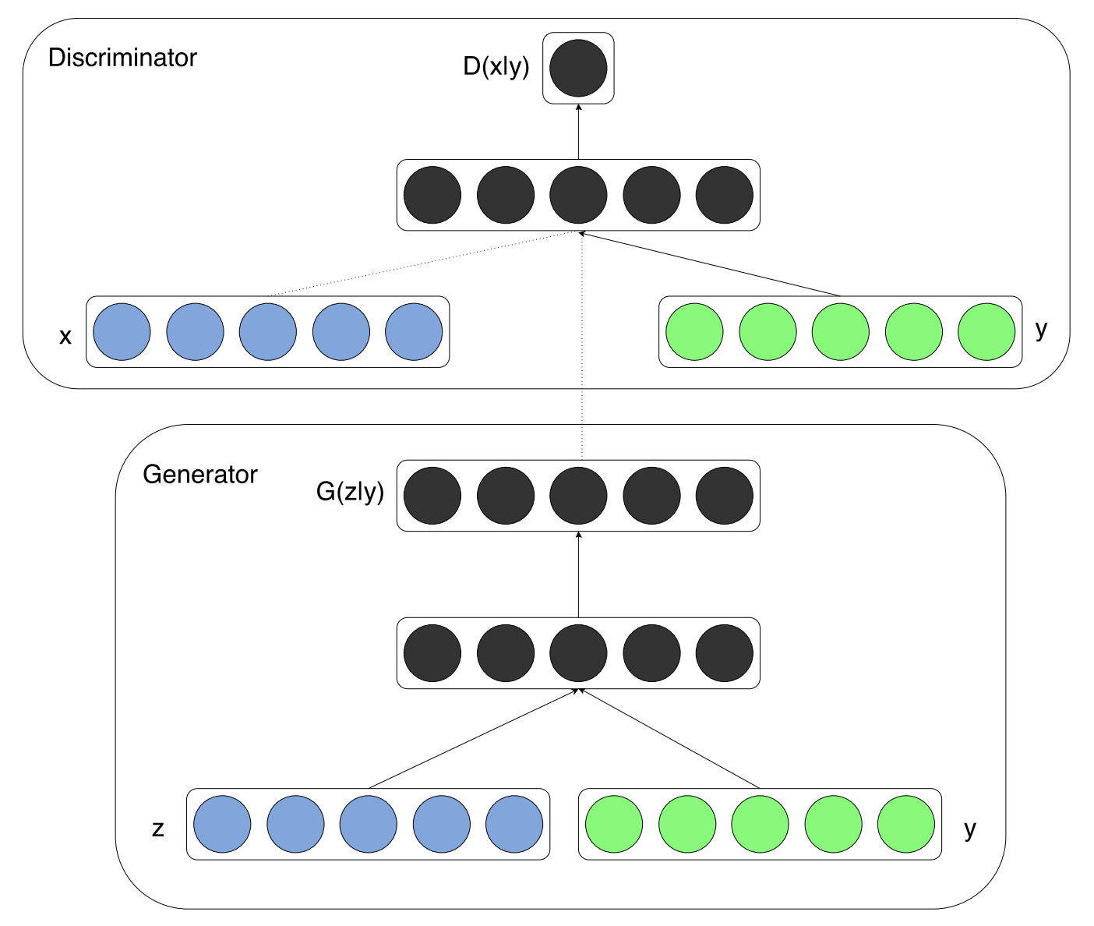
Conditional GANs
Discriminator input: image and class label
Generator input: white noise and class label
Generate images according to the class label
Conditioned on labels
Notes:
(Yintao) Unconditioned GANs only take random numbers as input. It has no control on modes of the data being generated. To control it, we implemented a conditional GAN, which takes both the random vector and a class label as input. So the discriminator not only decides whether the image is fake but also decides whether the image is from this class. In order to deceive the discriminator, the generator can learn the meanings of the class labels, and generate samples with respect to them.

Slide 15
Conditional Generator
Label Input
(1, 1)
Embedding
(50, 1)
Dense
(7*7, 1)
Latent Input
(128, 1)
Dense
(7*7*128, 1)
Concat/Reshape
(7, 7, 129)
Conv2DTrans
(14, 14, 128)
Conv2DTrans
(112, 112, 128)
Conv2DTrans
(56, 56, 128)
Conv2DTrans
(28, 28, 128)
Conv2D
(112, 112, 3)
Output
(112, 112, 3)
Notes:
The structure of the conditional generator is very similar to which in DCGAN. But it has two inputs, the label input and the latent input. The label is embedded as a vector and then reshaped as an additional chanel of the input. Then the transposed convolutional layers upsample the low resolution channels into high resolution channel and output the image.(Yintao)

Slide 16
Conditional Discriminator
Label Input
(1, 1)
Embedding
(50, 1)
Dense
(112*112, 1)
Image Input
(112, 112, 3)
Concat/Reshape
(7, 7, 129)
Conv2D
(56, 56, 128)
LeakyReLu
Dropout
(10352, 1)
Flatten
(10352, 1)
Conv2D
(28, 28, 128)
Leaky
ReLu
Dense
(1, 1)
Sigmoid
Output
(1, 1)
Binary Crosentropy
Notes:
The discriminator also take two inputs, the label will be embedded as a vector and then reshaped as an additional channel with image. Then the convolutional layers will downsample it to get a final sigmoid output.(Yintao)

Slide 17

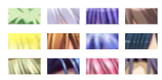
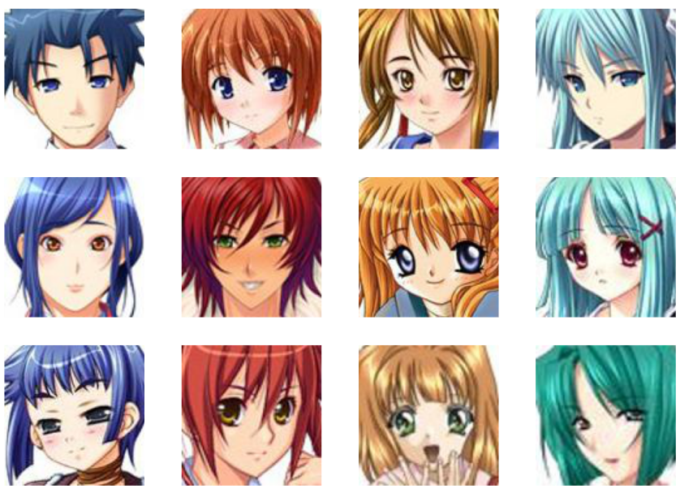
K-Means Clustering
Reshape
Hair area
Problem: No label!
Applied K-means to cluster avatars according to hair color
Selected 4 colors, blue, red, yellow, and green, as training data
K-Means
Blue
Red
Yellow
Green
Notes:
However, the original dataset has no labels. We tried to create labels and classify images by ourselves. An obvious pattern is the hair color. We found in most images, a certain area is always filled with hairs. So we can calculated the average color of that area and clustered them using the K-means algorithm. Then we picked the clusters with blue, red, yellow and green hair as the training data.(Yintao)

Slide 18
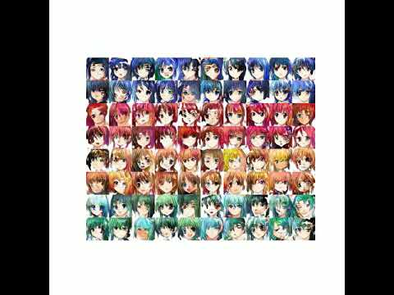
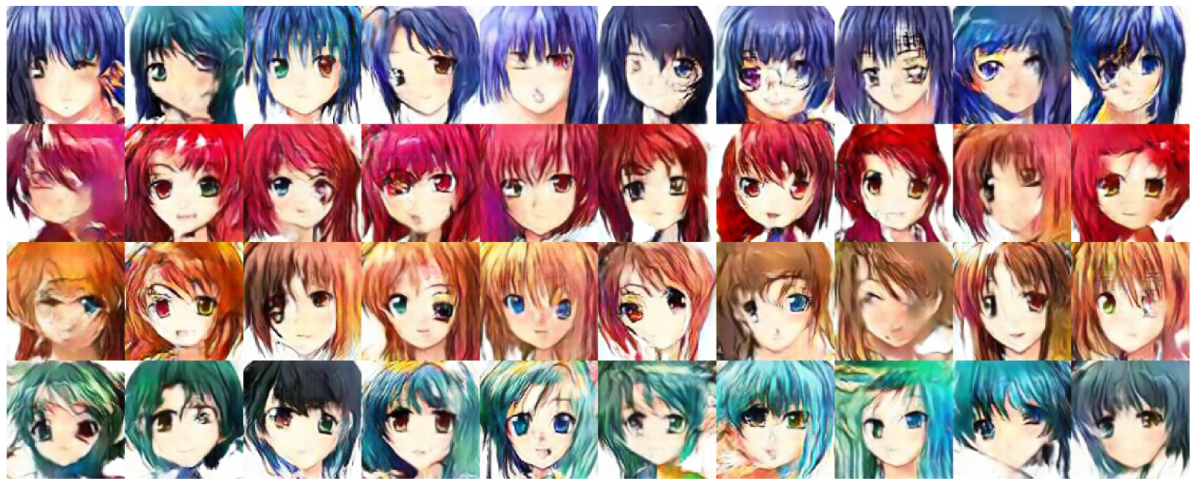
CGAN Result
Notes:
The left-hand side is the generated examples, each row represents one hair color. And the right-hand side is the training process. We can see the model successfully generated samples with assigned color labels, also imitated the details such as hair texture, face shape. But the symmetry of the eye is flawed as the DCGAN.(Yintao)

Slide 19
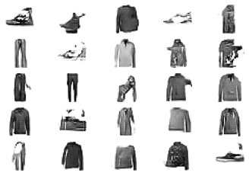
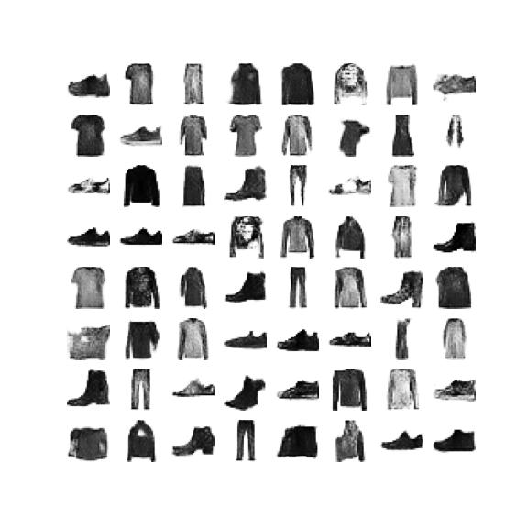
RESULTS FOR FASHION MNIST
GANS
DCGANS
Notes:
We trained the Gan and DCGAN on the fashion mnist and tried to generate images of cloths. We found that the DCGANS produced better results than the GANS because of the unique Convolutional layers that helped with the image tasks. (Javin)

Slide 20
RESULTS FOR ANIME FACE DATASET
DCGANS
CGANS
Notes:
We were curious about the CGans or Conditional Gans and we compared it to the DCGAN to see if the conditions helped with the performance. Overall, we see that the images produced by the Cgans is better than DCGANS. (Javin)

Slide 21
Future Work
Stability problem:
The training failed sometimes
Discriminator is too strong
Image quality problem:
Symmetry of the eyes
To improve the stability:
Wasserstein GAN or Wasserstein GAN with gradient penalty
To improve the image quality:
StyleGAN
Notes:
We noticed some problems during the training process, one is the instability problem, the training sometimes failed when training, and the discriminator is too strong and the generator cannot keep improving in this case. We did some research and find the Wasserstein GAN could imitate this problem. We tried this method but due to the time and resource limit the model cannot generate high quality samples yet. Also, we find a new model called StyleGAN could improve the image quality. We plan to implement it in the future.(Yintao

Slide 22
Thank you
Any Questions?
Notes:
(Yintao)

Slide 23
Citations:
Amyjang. “TensorFlow: Fashion MNIST DCGAN Tutorial.” Kaggle, Kaggle, 10 June 2020, www.kaggle.com/amyjang/tensorflow-fashion-mnist-dcgan-tutorial/comments.
bchao1. “bchao1/Anime-Face-Dataset.” GitHub, github.com/bchao1/Anime-Face-Dataset.
Brownlee, Jason. “A Gentle Introduction to Batch Normalization for Deep Neural Networks.” Machine Learning Mastery, 3 Dec. 2019, machinelearningmastery.com/batch-normalization-for-training-of-deep-neural-networks/.
Brownlee, Jason. “A Gentle Introduction to Batch Normalization for Deep Neural Networks.” Machine Learning Mastery, 3 Dec. 2019, machinelearningmastery.com/batch-normalization-for-training-of-deep-neural-networks/.
Brownlee, Jason. “A Gentle Introduction to Batch Normalization for Deep Neural Networks.” Machine Learning Mastery, 3 Dec. 2019, machinelearningmastery.com/batch-normalization-for-training-of-deep-neural-networks/.
“Deep Convolutional Generative Adversarial Network : TensorFlow Core.” TensorFlow, www.tensorflow.org/tutorials/generative/dcgan.
“How Many People Watch Anime?” Quora, www.quora.com/How-many-people-watch-anime#:~:text=On%20an%20estimate%20globally%2C%20about%2085%20million.
Huber, Johann. “Batch Normalization in 3 Levels of Understanding.” Medium, Towards Data Science, 9 Nov. 2020, towardsdatascience.com/batch-normalization-in-3-levels-of-understanding-14c2da90a338#b93c.
Mirza, Mehdi, and Simon Osindero. “Conditional Generative Adversarial Nets.” ArXiv.org, 6 Nov. 2014, arxiv.org/abs/1411.1784.
Mrigendraagrawal. “Introduction to GANIME.” Kaggle, Kaggle, 8 July 2021, www.kaggle.com/mrigendraagrawal/introduction-to-ganime.
Nair, Amal. “How To Build A Generative Adversarial Network In 8 Simple Steps.” Analytics India Magazine, 15 Feb. 2021, analyticsindiamag.com/how-to-build-a-generative-adversarial-network-in-8-simple-steps/.
“r/Anime - Top 100 Anime of Germany (German MAL Equivalent) + Comparison to MAL Rankings.” Reddit, www.reddit.com/r/anime/comments/5ohyy2/top_100_anime_of_germany_german_mal_equivalent/.
Watson, Amy. “Topic: Netflix.” Statista, www.statista.com/topics/842/netflix/.
Wolf, Sarah. “ProGAN: How NVIDIA Generated Images of Unprecedented Quality.” Medium, Towards Data Science, 20 Dec. 2018, towardsdatascience.com/progan-how-nvidia-generated-images-of-unprecedented-quality-51c98ec2cbd2.

